Slide 1
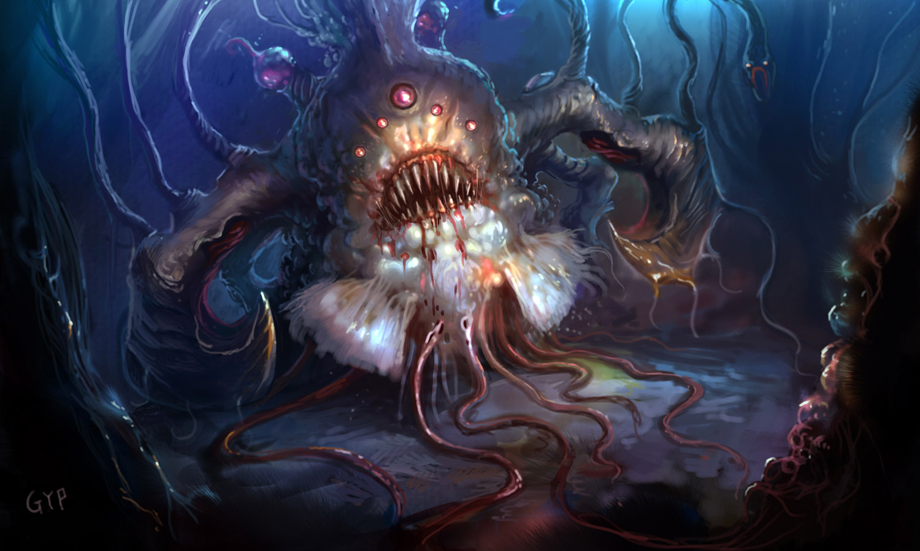
What is a “Monster”?

Slide 2
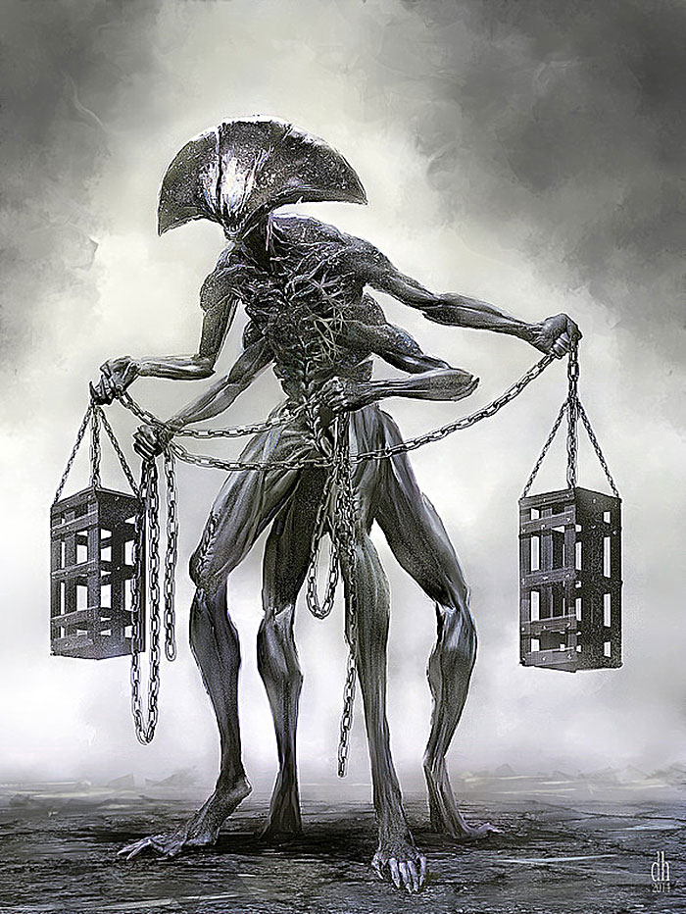
What is a “Monster”?
Oxford English Dictionary:
1. Originally: a mythical creature which is part animal and part human, or combines elements of two or more animal forms, and is frequently of great size and ferocious appearance. Later, more generally: any imaginary creature that is large, ugly, and frightening.

Slide 3
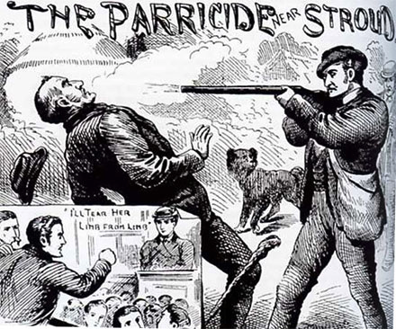
What is a “Monster”?
2. Something extraordinary or unnatural; an amazing event or occurrence; a prodigy, a marvel.
(e.g., parricide, infanticide)

Slide 4

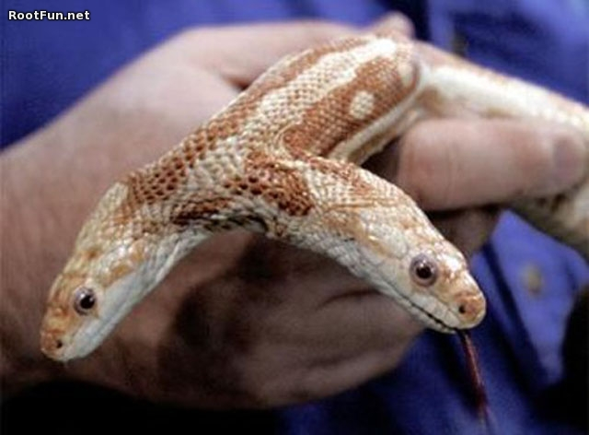
What is a “Monster”?
3. A malformed animal or plant; (Med.) a fetus, neonate, or individual with a gross congenital malformation, usually of a degree incompatible with life.

Slide 5
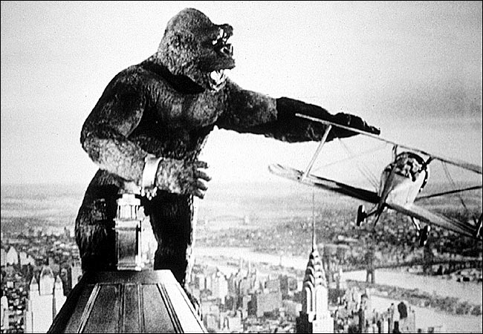
What is a “Monster”?
King Kong (dir. Cooper, 1933)
4. A creature of huge size; Anything of vast or unwieldy proportions; an extraordinarily large example of something.

Slide 6
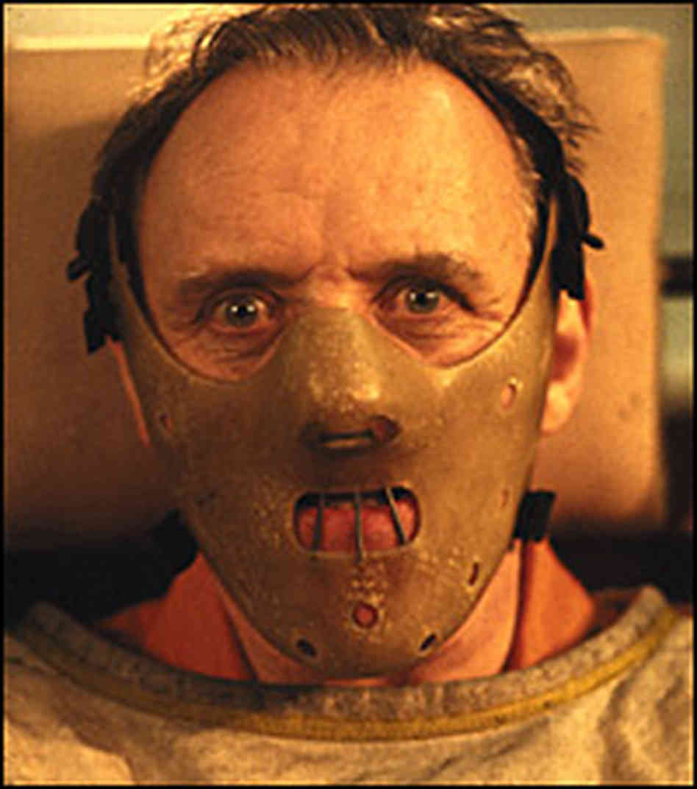
What is a “Monster”?
5. A person of repulsively unnatural character, or exhibiting such extreme cruelty or wickedness as to appear inhuman; a monstrous example of evil, a vice, etc.
Hannibal Lecter (Anthony Hopkins), The Silence of the Lambs

Slide 7
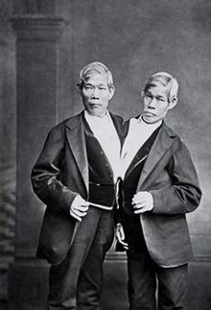
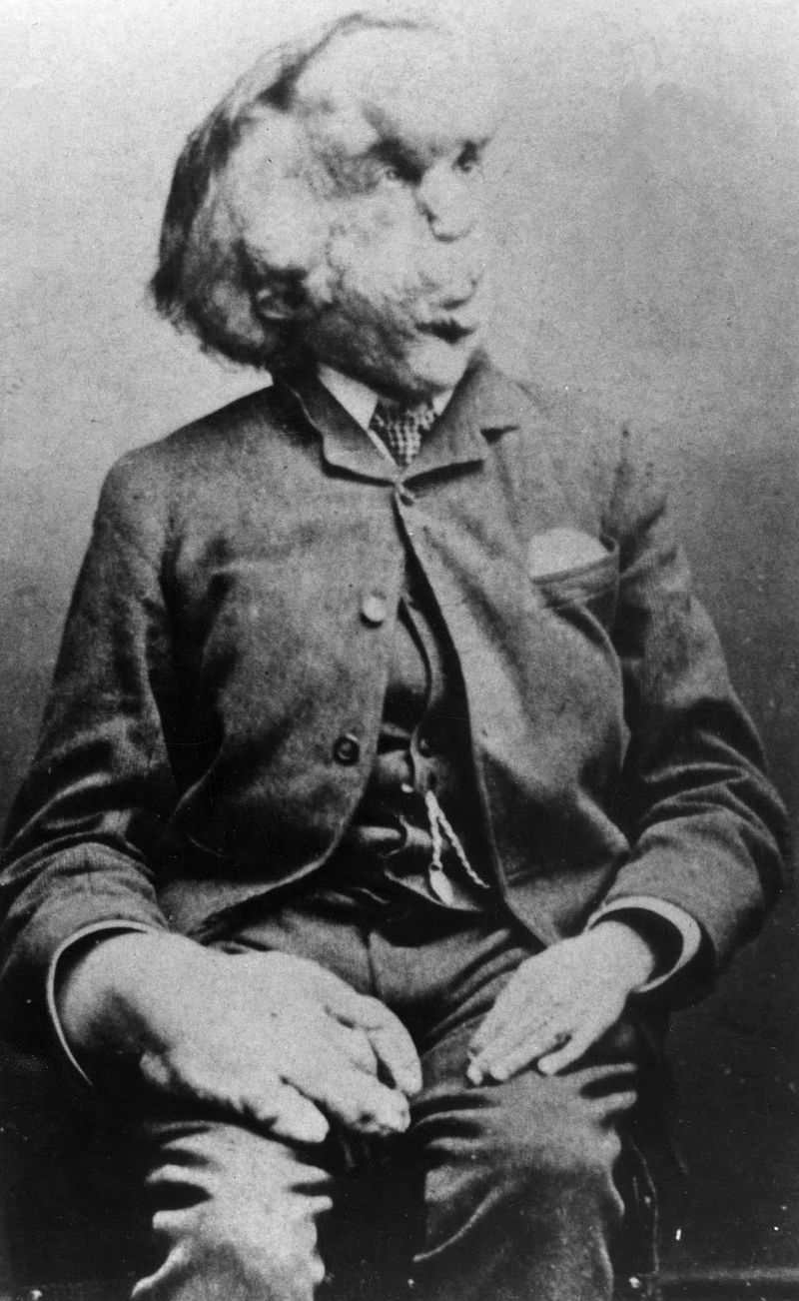
What is a “Monster”?
6. An ugly or deformed
person, animal, or thing.
Photo: Joseph Merrick,
so-called “Elephant Man”
Photo: Chang & Eng Bunker, so-called “Siamese Twins”

Slide 8
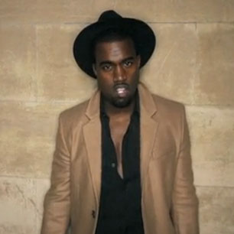
What is a “Monster”?
7. orig. U.S. An extraordinarily good or remarkably successful person or thing.
Adj., monstrous:
a) Of extraordinary size or extent; huge; gigantic;
b) Outstanding, extraordinarily good; remarkably successful.

Slide 9
What is a “Monster”?
Seven Traits:
Hybridity and/or Inhumanity
Great size
Abnormality
Deformity
Cruelty
Ugliness
Fame/Success
“Unnatural”
(opposed to or a deviation from ‘nature’)

Slide 10
Signal Question: Excercise
Watch the music video for Kanye West’s “Monster.”
Which definitions or traits of ‘monstrosity’ can you identify? Cite as many as you see.
Now think about how they are used. What is the implication for race? For gender?
Write for about 5 minutes, then confer with a classmate. Pay attention both to lyrics and imagery.

Slide 11
Critical Perspective 1
Mikhail Lyubansky: “The implication is unmistakable: Monstrous men -- the ones who treat women as inanimate objects -- are sexually attractive, which means that, by extension, monstrous behavior on the part of men is sexually attractive, while, for women, what's sexually desirable is passivity, lifelessness, and death.”

Slide 12
Critical Perspective 2
Ann J. Simonton: “When West's lyrics repeat, "Everybody knows I'm a mutha-f---ing monster," is it because he is surrounded by death and flesh-eating zombie types, or is he correctly acknowledging how black males are unfairly demonized in the media and in reality?”

Slide 13
Critical Perspective 3
Latoya Peterson: “Kanye is . . . upholding the ideals of white supremacy. Even in death, white women are worthy of love, tenderness, and a starring role in male fantasies. Brown women are relegated to the background, left to their own monstrous devices, shadow creatures performing their roles. Neither depiction is great for women – it’s essentially a loss all the way around.”

